Slide 1
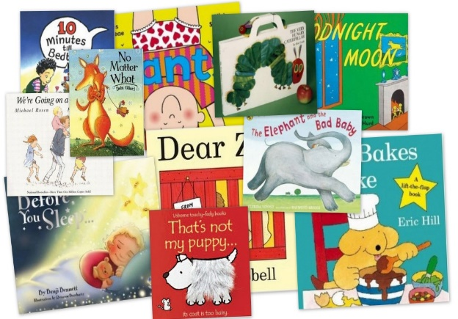
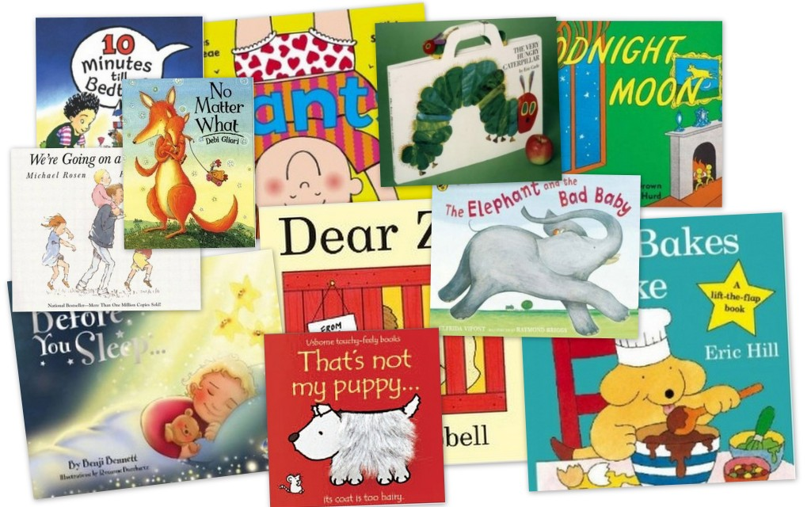
Belford Primary School
Reading Workshop for Parents and Carers
January 2023

Slide 2
Ways we teach reading in school…
Phonics using Read, Write, Inc
Shared reading
Whole class guided reading (VIPERS)
Independent reading
Focused reading activities
Reading across the curriculum
Class novels and stories

Slide 3
What is Phonics?
Phonics is a way of teaching children how to read and write. It helps children hear, identify and use different sounds that distinguish one word from another in the English language.
Written language can be compared to a code, so knowing the sounds of individual letters and how those letters sound when they’re combined will help children decode words as they read.
Understanding phonics will also help children know which letters to use when they are writing words.

Slide 4

In school we follow the Ruth Miskin phonics scheme, Read, Write, Inc. This a ‘cohesive and creative’ approach to phonics, ensuring all children learn to read and write at their own rate.
It is delivered to all children in Reception, year 1 and 2 daily.
It is also delivered to children in year 3 and 4 who continue to need additional support with phonics.

Slide 5
It’s very important to pronounce the
individual sounds correctly.
https://www.youtube.com/watch?v=TkXcabDUg7Q

Slide 6
Key aspects of phonics
Fred Talking- Fred is a frog who helps the children to segment (break up) the sounds in words eg c-a-t. When children are reading or writing and they finding it difficult, the first skill we use is decoding. This is where the children show on their fingers the sounds they can see or hear.
Red words- these are words that are common or frequent in a text and cannot be segmented and therefore need to be learnt on sight. For example ‘the’ can’t be segmented as it does not make sense.
Blending- Blending is when you put the sounds together to say the whole word, eg p-ar-k, park.

Slide 7
Dots and dashes- when reading a word, the children will start by Fred talking it or sounding it out. However this strategy doesn’t always work if they have not identified the sounds correctly. To help we add ‘dots and dashes’ underneath the sounds to help them to see what sounds are in the words.
Special friends-. It is essential the children say the whole word after segmenting. Special friends or digraphs/trigraphs are 2 3 letters that make 1 sound eg ar, or, ch, igh. These sounds have a dash underneath.

Slide 8
Examples of phonics activities you can do at home…
Chalking letters / words on the pavement
Bingo
Magnetic letters in the bath or on a tray
Sharing ditty sheets / school books daily
Online games :
www.phonicsplay.co.uk
www.phonicsbloom.com

Slide 9
Understanding (comprehension)
Being able to read does not mean you understand what you read.
Your child might sound like a good reader but may not necessarily understand what the text means.
The best way to develop understanding is to talk about texts.

Slide 10
Reading requires two skills
Phonics and Word Recognition
The ability to recognise words presented in and out of context.
The ability to blend letter sounds (phonemes) together to read words.
Understanding
The ability to understand the meaning of the words and sentences in a text.
The ability to understand the ideas, information and themes in a text.
If a child understands what they hear, they will understand the same information when they read.

Slide 11
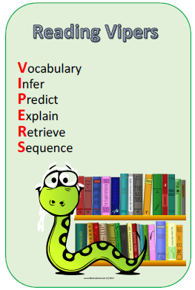
Whole School use of VIPERS to teach reading skills

Slide 12
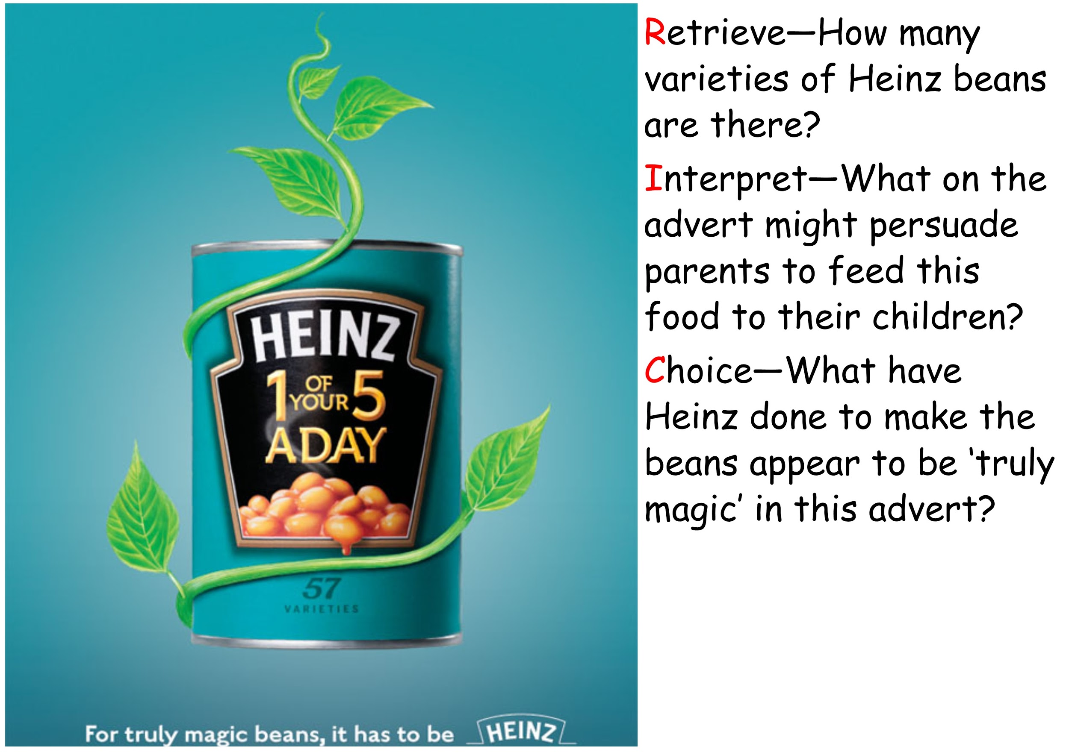
How many varieties of Heinz beans are there?
Retrieval
What, on the advert, might persuade parents to feed this to their children?
Inference
Explain what Heinz have done to make the beans appear to be ‘truly magic’ in this advert.
Explain the author’s choices

Slide 13
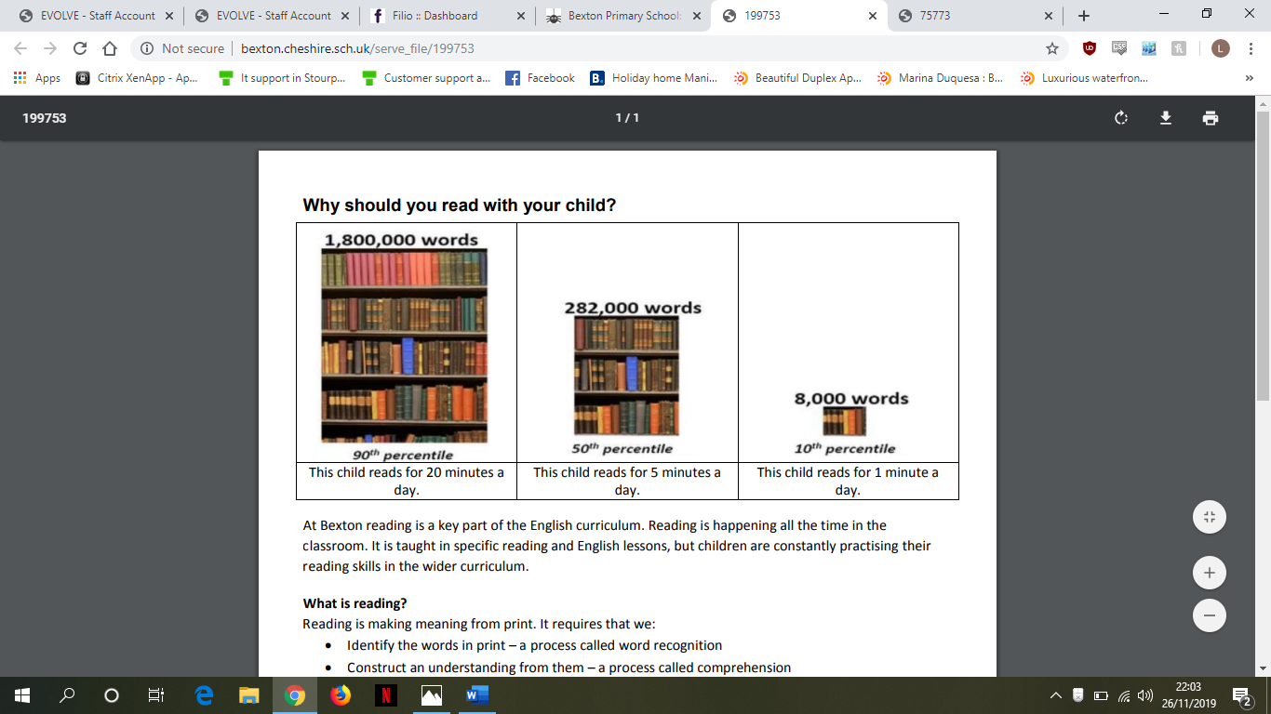
Reading at Home

Slide 14
Reading at Home – Enjoy!
Make reading visible - have books available in your home
Share books every day – you can visit the school library after school every Thursday to borrow a book with your child.
Talk about books.
Sit and listen - don’t do chores around the reader.
Respect choices.
Show That You Read Too
Hearing an adult read from a text that is a higher level than they would be able to access on their own is really important for developing new vocabulary. Why not share an interesting article you’ve found online with your child so that you can learn together?

Slide 15
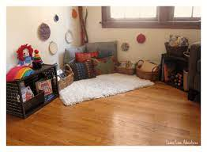
Read with Younger Siblings
If your child has younger siblings, try allowing them to lead story time one evening. Encourage them to think about questions they can ask about the text.
Reading Spaces
Why not set up a special reading area in your house? Try to make somewhere quiet and comfortable where reading is fun.

Slide 16
What to do if your child is stuck
Use phonics first. What sound does the word begin with? Can you say the sounds in the word? Blend them together.
Read to the end of the sentence. What would make sense?
What is the text about – what might fit here?
Does it sound right?
Look at the picture. Does it help?
Try a paired reading approach to support reluctant readers.

Slide 17
Talking about books
Do you like this book; why?
Who is your favourite character?
Tell me about a character in the book.
Which words tell you what the character is like?
How would you feel?
What do you think will happen next?
What would you do?
What have you learned about …… in your book?
What can you tell me about…?

Slide 18
Hearing your child read
Choose a quiet time and give your child your full attention
Give support if required using the strategies explained earlier;
Explain the meaning of new words;
Talk about the text using open questions.

Slide 19
Have Fun!

