Slide 1

Year Four Multiplication Check
Parents information

Slide 2
Why are times tables important?
Times tables are fundamental to support children and they underpin everything in Maths. It is vital that all children know their multiplication facts up to 12 x 12.
Knowing the multiplication facts up to 12 x 12 will give children the essential knowledge needed to be proficient with Years 5 and 6 Curriculum.

Slide 3
Purpose
The purpose of the check is to determine whether your child can fluently recall their times tables up to 12, which is essential for future success in maths. It will also help us as teachers to identify if your child may need additional support.

Slide 4
Access for all children..
There are several access arrangements available for the check, these can be used to support pupils with specific needs. Your child’s teacher will ensure that the access arrangements are appropriate for your child before they take the check in June. The check has been designed so that it is inclusive and accessible to as many children as possible, including those with special educational needs or disability (SEND) or English as an additional language (EAL). However, there may be some circumstances in which it will not be appropriate for a pupil to take the check, even when using suitable access arrangements. If you have any concerns about your child accessing the check, you should discuss this with myself, Mrs Ferguson or Mrs Rainey.

Slide 5
When is it?
The national times table check is a test for all year four pupils and takes place between the 6th and 24th of June 2022.

Slide 6
How will they be tested?
The children will be given 25 questions. The questions will all be multiplication and there will be a particular focus on the 6, 7, 8, 9 and 12 times table (as they are the hardest to learn!). The test will be carried out on iPads.

Slide 7
Will I find out my child’s score?
Yes, we will share your child’s score with you, as we would with all National Curriculum assessments. There is no pass mark for the check.

Slide 8
What does the multiplication check involve?
It is an on-screen check consisting of 25 times table questions. Your child will be able to answer 3 practice questions before taking the actual check. They will then have 6 seconds to answer each question. On average, the check should take no longer than 5 minutes to complete.

Slide 9
Example- this is very similar to the NTC.
https://mathsframe.co.uk/en/resources/resource/477/Multiplication-Tables-Check

Slide 10
What can I do to support my child?
We practise our timetables on a regular basis at school. We would love for your children to practise with you at home so that they feel confident when completing the test.
The easiest way is to challenge your child. 8x6 is?

Slide 11

Encourage children to play Times Table Rockstars as often as possible. Small 5 minute daily sessions will help children to learn times tables more than one long session a week. The soundcheck is very similar to the multiplication check.
Quiz your child at home regularly. This could be when making dinner or on the journey to school, chanting when heading up the stairs or even when in the bath.
Short bursts are the best way forward.

Slide 12
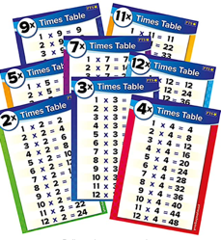
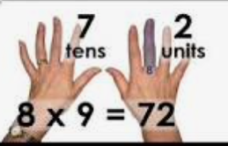
Display a poster with all of the times tables facts on at home.
We teach lots of tricks to help the children remember
the times tables. You could learn a trick together.
Create flash cards with your children and let them play with friends, siblings, grandparents. They could write the answer on the back and test themselves.

Slide 13
We use lots of songs to teach our times tables in school. Children can recognise these from you tube by typing in 4 times table song. Let them sing along with these at home. Children could also make their own times tables.

Slide 14
Any times tables practise that the children can do at home will really support them to become proficient in their times tables and help them with their everyday maths learning.

Slide 15
Any questions?

Slide 16
We value your support. Thank you for supporting us here at Belford Primary.

