Slide 1

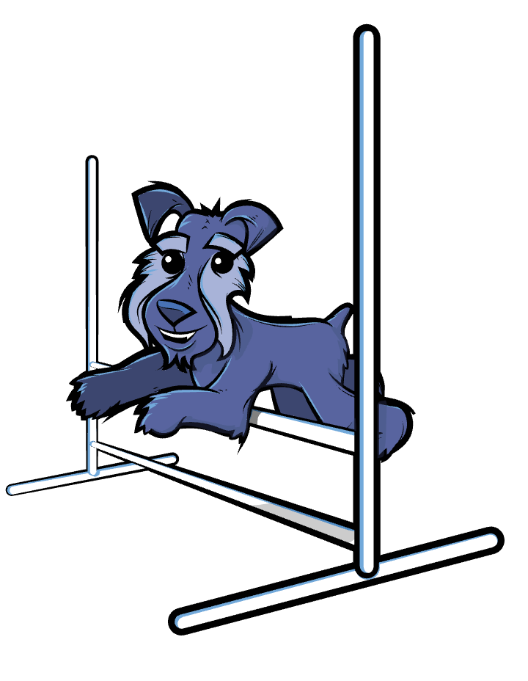
Active & Passive Voice
The dog jumped over the hurdle.
The hurdle was jumped over by the dog.
Emma walked the dog.
The dog was walked by Emma.

Slide 2
The subject is what the clause is about.
Parts of a Clause
A clause is a group of words which contains a verb.
All verbs have a subject.
This clause is about Max.
Max threw
Emma ate
The dog chased
This clause is about Emma.
This clause is about the dog.
In some clauses there is something the verb acts on.
This is called the object.

Slide 3

ANSWERS
Identifying Subject, Verb and Object
I lost my dog.
Raj looked for the dog.
He found her shut in a box.
Raj dragged the box.
I lost my dog.
Raj looked for the dog.
He found her shut in a box.
Raj dragged the box.
he
dragged
the box
Can you spot the subject, verb and object in these clauses?

Slide 4
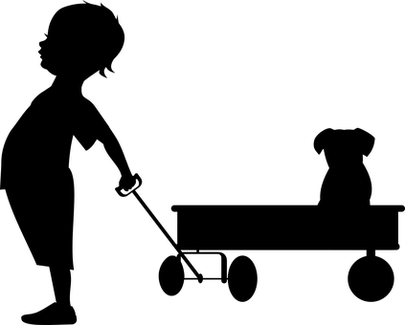
Active voice is when the subject ‘does’ the verb.
Active Voice
Max was doing the pulling.
Max pulled the cart.
The dog ate the sandwich!
The dog chased the cat.
The subject ‘acts’ out the verb in the active voice.
The dog was doing the eating.
The dog was doing the chasing.
Max
pulled
subject verb object
the cart

Slide 5
Passive Voice
Passive voice changes the emphasis of a sentence.
Passive voice is when the verb is done to the subject.
This clause is about the glass.
The verb to drop happened to the glass.
The glass was broken by the dog.
The pie was eaten by the dog.
The cat was chased by the dog.
This clause is about the pie.
The verb to eat happened to the pie.
This clause is about the cat.
The verb to chase happened to the cat.

Slide 6
We use is, are, was, were, to form verbs for passive voice (auxiliary verbs)
Passive Voice
The horn was pressed by the angry driver.
A secret was revealed when we opened the door.
The dog was scared by the clown.
Sometimes the person doing the action is not included in the sentence.
The horn was pressed by the angry driver.
The children were scared by the thunder.
The horn was pressed.
The dog was scared.

Slide 7
Active: subject does the verb
Passive: verb done to the subject
Active and Passive Voice
The dog found a bone.
A bone was found by the dog.
The carpet was chewed by the dog.
The dog chewed the carpet.
The toys were hidden by the dog.
The dog hid the toys.
Active
Passive
ANSWERS
Passive
Active
Passive
Active
Which of these have an active voice and which have a passive voice?

Slide 8


Active: subject does the verb
Passive:
verb done to subject
Choosing Active and Passive Voice
You can change the emphasis of a sentence through the voice you use.
The dog chewed the carpet.
The carpet was chewed by the dog.
The carpet was chewed.
emphasis on the dog
Active
emphasis on the carpet
Passive
emphasis on the carpet – dog off the hook!
Passive

Slide 9

Active: subject does the verb
Passive:
verb done to subject
Choosing passive voice
Passive voice is sometimes used in
formal or generalised writing...
Five portions of fruit should be eaten every day.
Care must be taken when using power tools.
The mixture was stirred.
By people in general.
It does not matter who stirred it.
or when elements are unknown
My bag has been stolen.
I do not know who stole it.
or to hide information
The hospital was unavoidably closed.
Football cards have been banned at our school.
I don’t want you to know who was responsible.

Slide 10

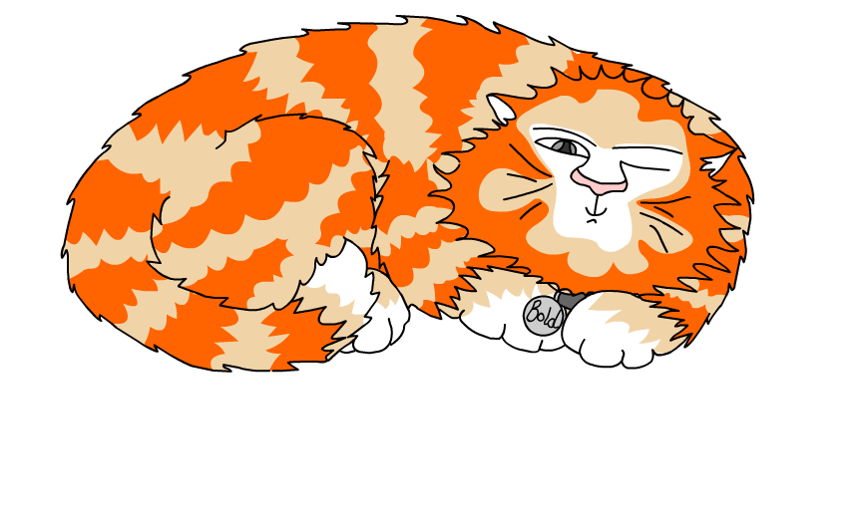
Explore more Hamilton Trust Learning Materials at https://wrht.org.uk/hamilton/ .

