Slide 1
Mental Health and Wellbeing
Information for Parents and Carers
Belford Primary School

Slide 2
What is Mental Health? How about Wellbeing?
Definitions
Mental Health
a person’s condition with regard to their psychological and emotional wellbeing.
Wellbeing
the state of being comfortable, healthy, or happy.
Oxford English Dictionary

Slide 4
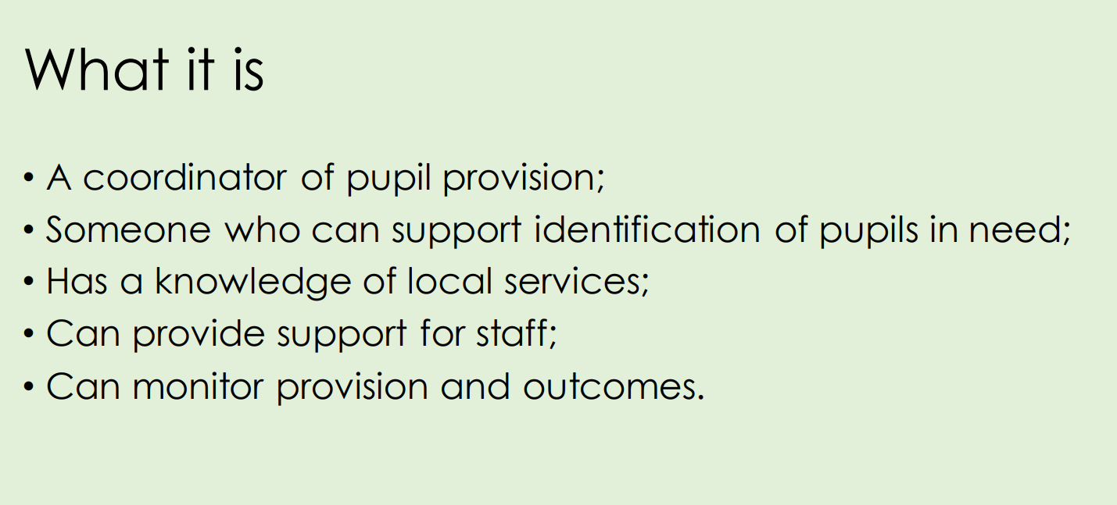
What is a mental health lead in school?

Slide 5
Mrs Rainey is the mental health lead in school.
Miss Foster is our ‘Stormbreak’ advocate in school. More about this to follow.
She supports Mrs Rainey in her role and also promotes positive mental health and wellbeing across the school.

Slide 6
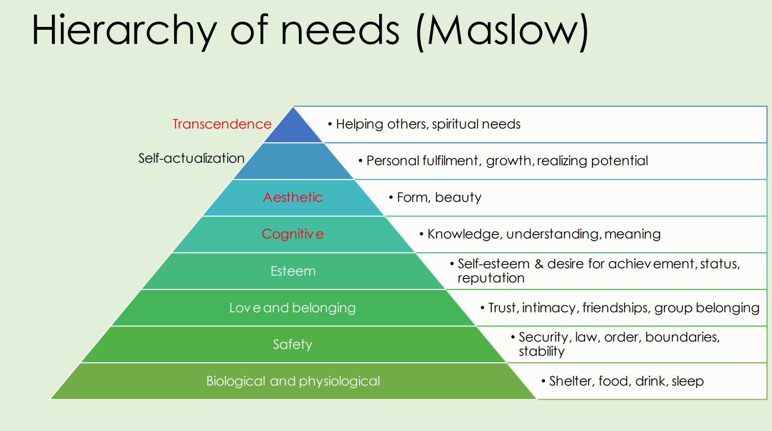

Slide 7
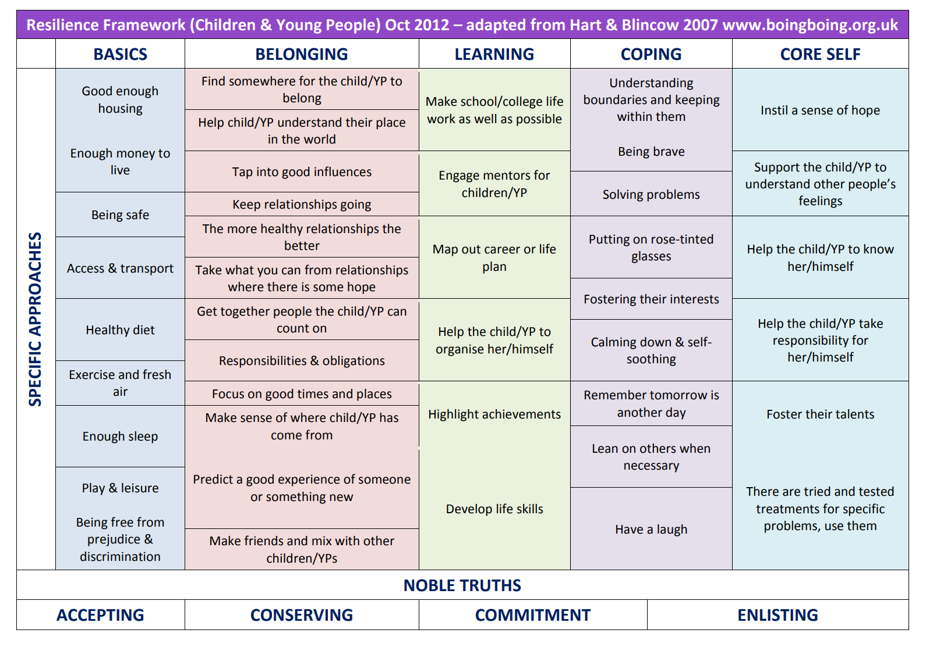

Slide 8
Five Ways to Wellbeing

Slide 10
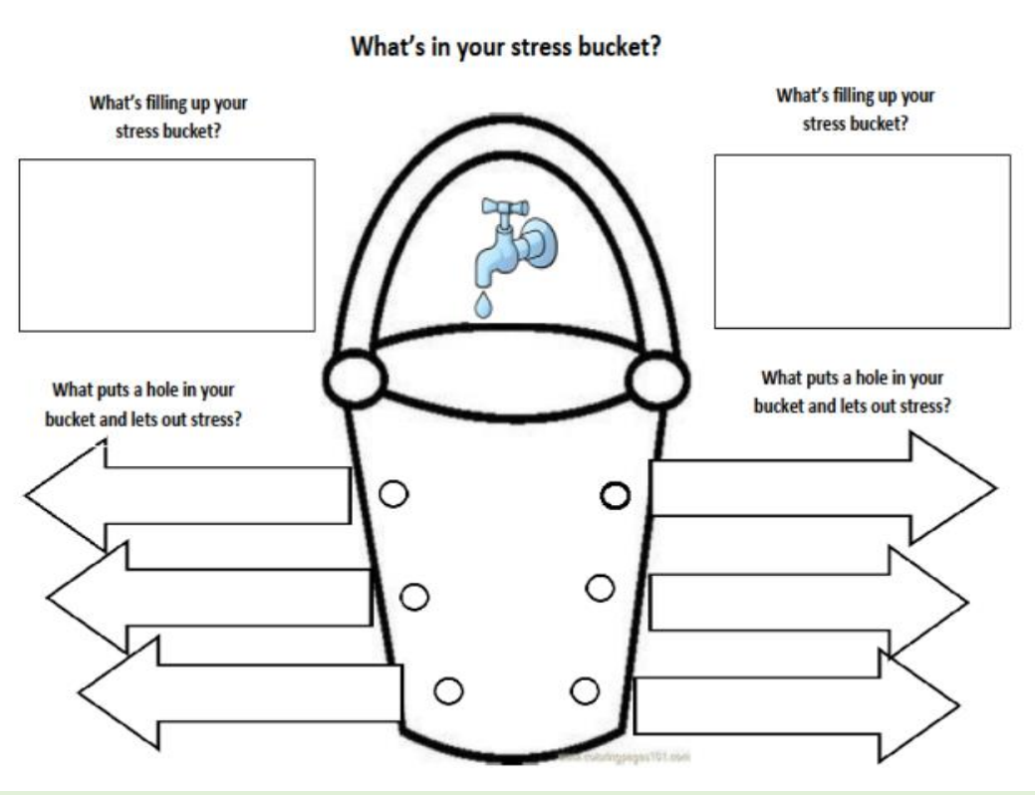

Slide 11
What is Stormbreak?
Stormbreak is a registered charity in England and Wales that supports children’s mental health through movement provision.
Stormbreak school training programmes are whole-school, preventative approaches that support primary aged children to develop a toolkit of skills and knowledge around their own wellbeing that will support them now and in the future.

Slide 12
About stormbreak - YouTube
Spiderman (relationships) - Bing video

Slide 13
Peer Support
Playground buddies
Rainbow benches
Wellbeing Ambassadors
Awareness Activities

Slide 14
Personal, Social, Health and Economic Education and Assembly Time
We have whole school themes for assemblies and PSHE that support mental health and wellbeing.
Picture News assemblies help the children to understand news stories from around the world and develop their emotional literacy.

Slide 15
Commando Joe’s Character Education Sessions
Every Thursday, the children take part in our CJ’s RESPECT programme.
They are working on…
Resilience
Empathy
Self-awareness
Positivity
Excellence
Communication and
Teamwork

Slide 16
Level of services
Pupil
Universal
Intensive services
Additional support
Specialist services
Depending on the pupil’s need they may be referred to different services.
Notes:
NG

Slide 17
Northumberland Referral Process for External Support
School Nursing Team (HUB referral : Parents and Mrs Rainey complete an online form together called a MAR form).
Northumberland Inclusive Education Service
SEND and Inclusion
Primary Mental Health Workers – NHS Foundation Trust
CYPS Children and Young People’s Service

Slide 18
Thank you for listening
Any questions?

