Slide 1
Indicating degrees of possibility
Using Modal Verbs

Slide 2
Modal Verbs
We can use modal verbs to help us express how likely something is.
I might become a teacher.
I could learn to play an instrument.
The opportunities available to me may be different in the future.
I will choose the things that I do.
Which are the modal verbs in these sentences?

Slide 3
Modal Verbs
Modal verbs are placed before the verb they are modifying.
The opportunities available may change.

Slide 4
Modal Verbs
Modal verbs are placed before the verb they are modifying.
People learn throughout their lives.
Add the modal verb ‘should’ to this sentence.
People should learn throughout their lives.

Slide 5
Indicating Degrees of Certainty using Modal Verbs
I might play for Manchester United.
I could play professionally.
I will play the best I can always.

Which sentence is most certain?

Slide 6
Using Modal Verbs negatively
I might not live in this city.
I cannot live in this city.
I will not live in this city.
I may not live in this city.

Slide 7
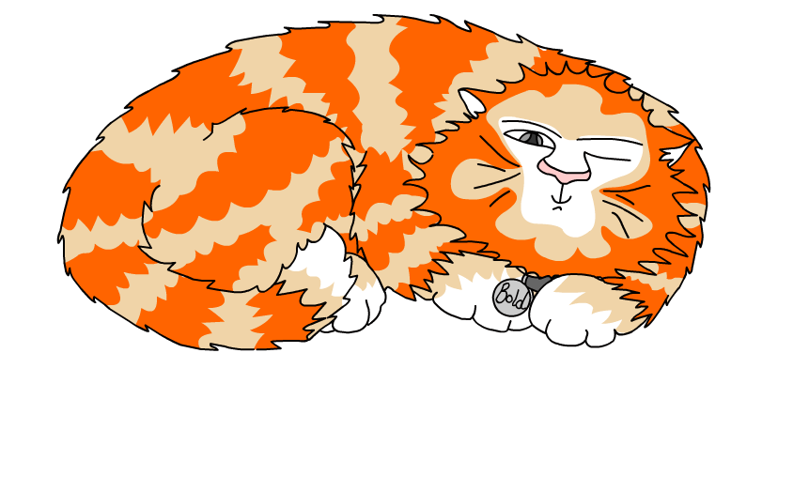
This is a Hamilton Trust Presentation. For more fantastic resources visit our website https://www.hamilton-trust.org.uk/ .

