Slide 1
Parent Information
2022

Slide 2
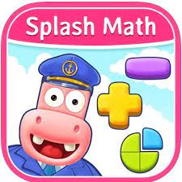
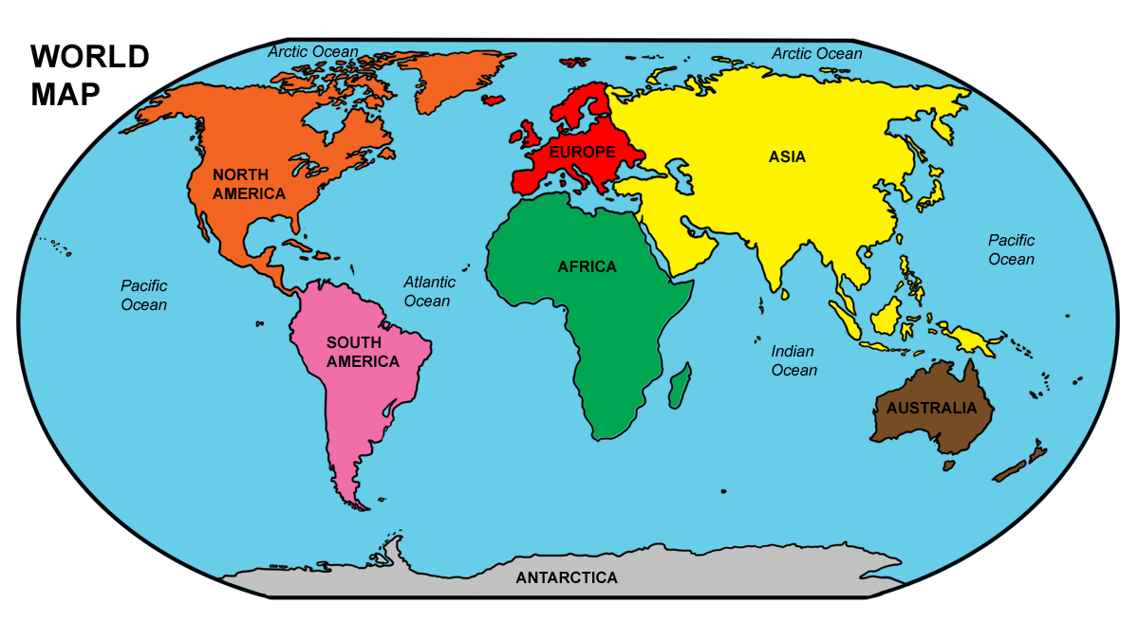
Learning in Class 2
Morning work
Commando Joe’s

Slide 3
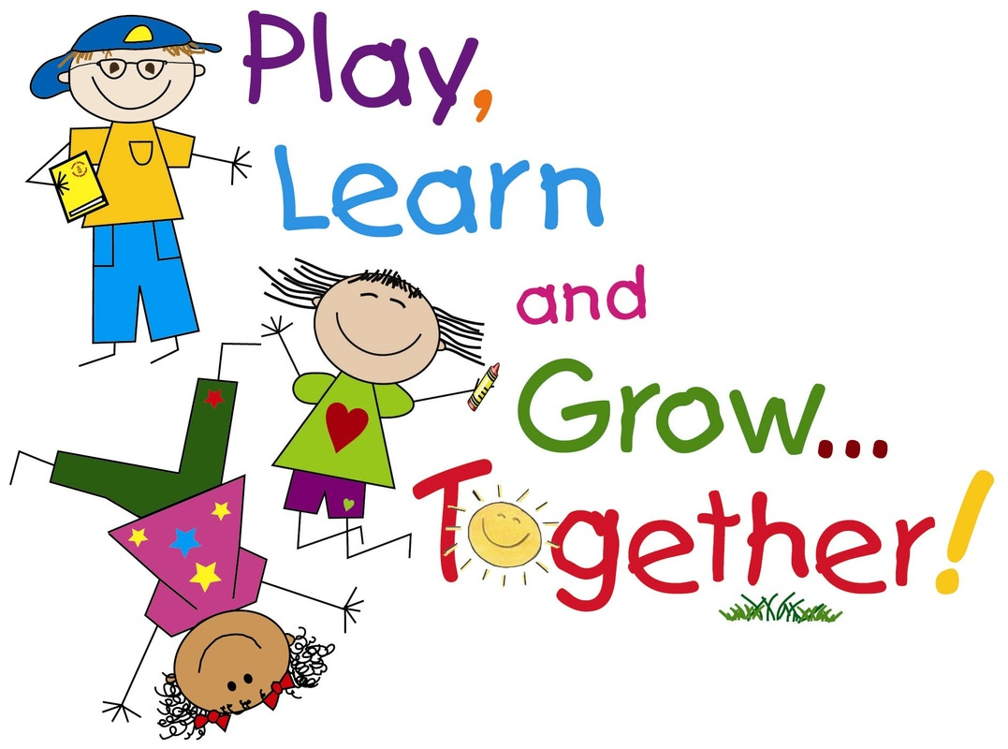
A Typical Day in Class 2
Morning Task (Children read home books / corrections to work)
Maths / Mental Maths
Break time (fruit for all /milk optional)
Phonics
Literacy (RWI, Power of Reading, Pie Cobbett- Talk for Writing)
Lunch Break
Guided Reading
Afternoon lesson (History, Geography, Science, Computing, RE, PE etc…)
Additional basic skills
Everybody Reading In Class or teacher reads a story

Slide 4
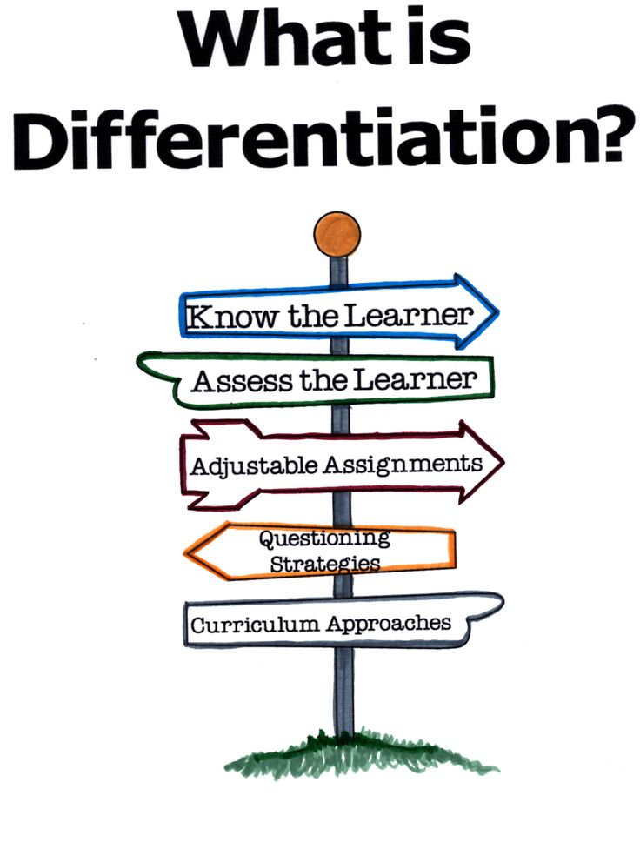
Learning in Class
Class 2 is made up of two year groups. This means, we have a wide range of learners who all have different learning needs to meet.
All tasks set are differentiated which means that work is either simplified or made more challenging. We have many resources to support learning and make lessons as practical and visual as possible.

Slide 5
End of Key Stage One Assessments 2022

Slide 6
What are end of key stage one assessments?
What you might know as SATs or Standard Attainment Tests, are national curriculum tests that are usually taken by children at the end of key stage one. These are just part of the picture.
All children are assessed during the last term of year 2 to judge what they have learned over the course of key stage one (years 1 and 2).
Teachers judge whether each child in their class has achieved the expected standards for the end of key stage one.
Teachers will use a range of evidence to support their judgements, including the children’s results in their national curriculum tests, as well as independent work in class.
Teachers will judge what a child is able to do independently and align this with the national expectations for a child at the end of key stage one.
Contents

Slide 7
What are children tested on?
Maths
Paper 1 - Arithmetic (20 minutes)
Addition, subtraction, multiplication and division, including finding fractions.
Paper 2 - Reasoning (35 minutes)
Solving problems and reasoning. 5 questions are read aloud and children have 30 minutes to answer the rest of the questions independently.
English Reading
Both reading papers contain a variety of texts which increase in difficulty. Paper 2 is more challenging that paper 1.
Paper 1 (30 minutes)
Short sections of text for the children to read with questions underneath for them to answer.
Paper 2 (40 minutes)
A reading booklet with texts and a question booklet to record answers in.
Contents

Slide 8
What are children tested on?
English
Grammar, Punctuation and Spelling
These are optional papers which can be used to support teacher judgements on children’s writing attainment.
Paper 1 - Spelling (15 minutes)
The children have a booklet of sentences with missing words. The teacher reads out the sentences and children write in the correct spellings.
Paper 2 - Grammar, punctuation and vocabulary (20 minutes)
A question and answer booklet which tests children’s knowledge of grammar and punctuation rules, as well as their vocabulary.
Contents

Slide 9
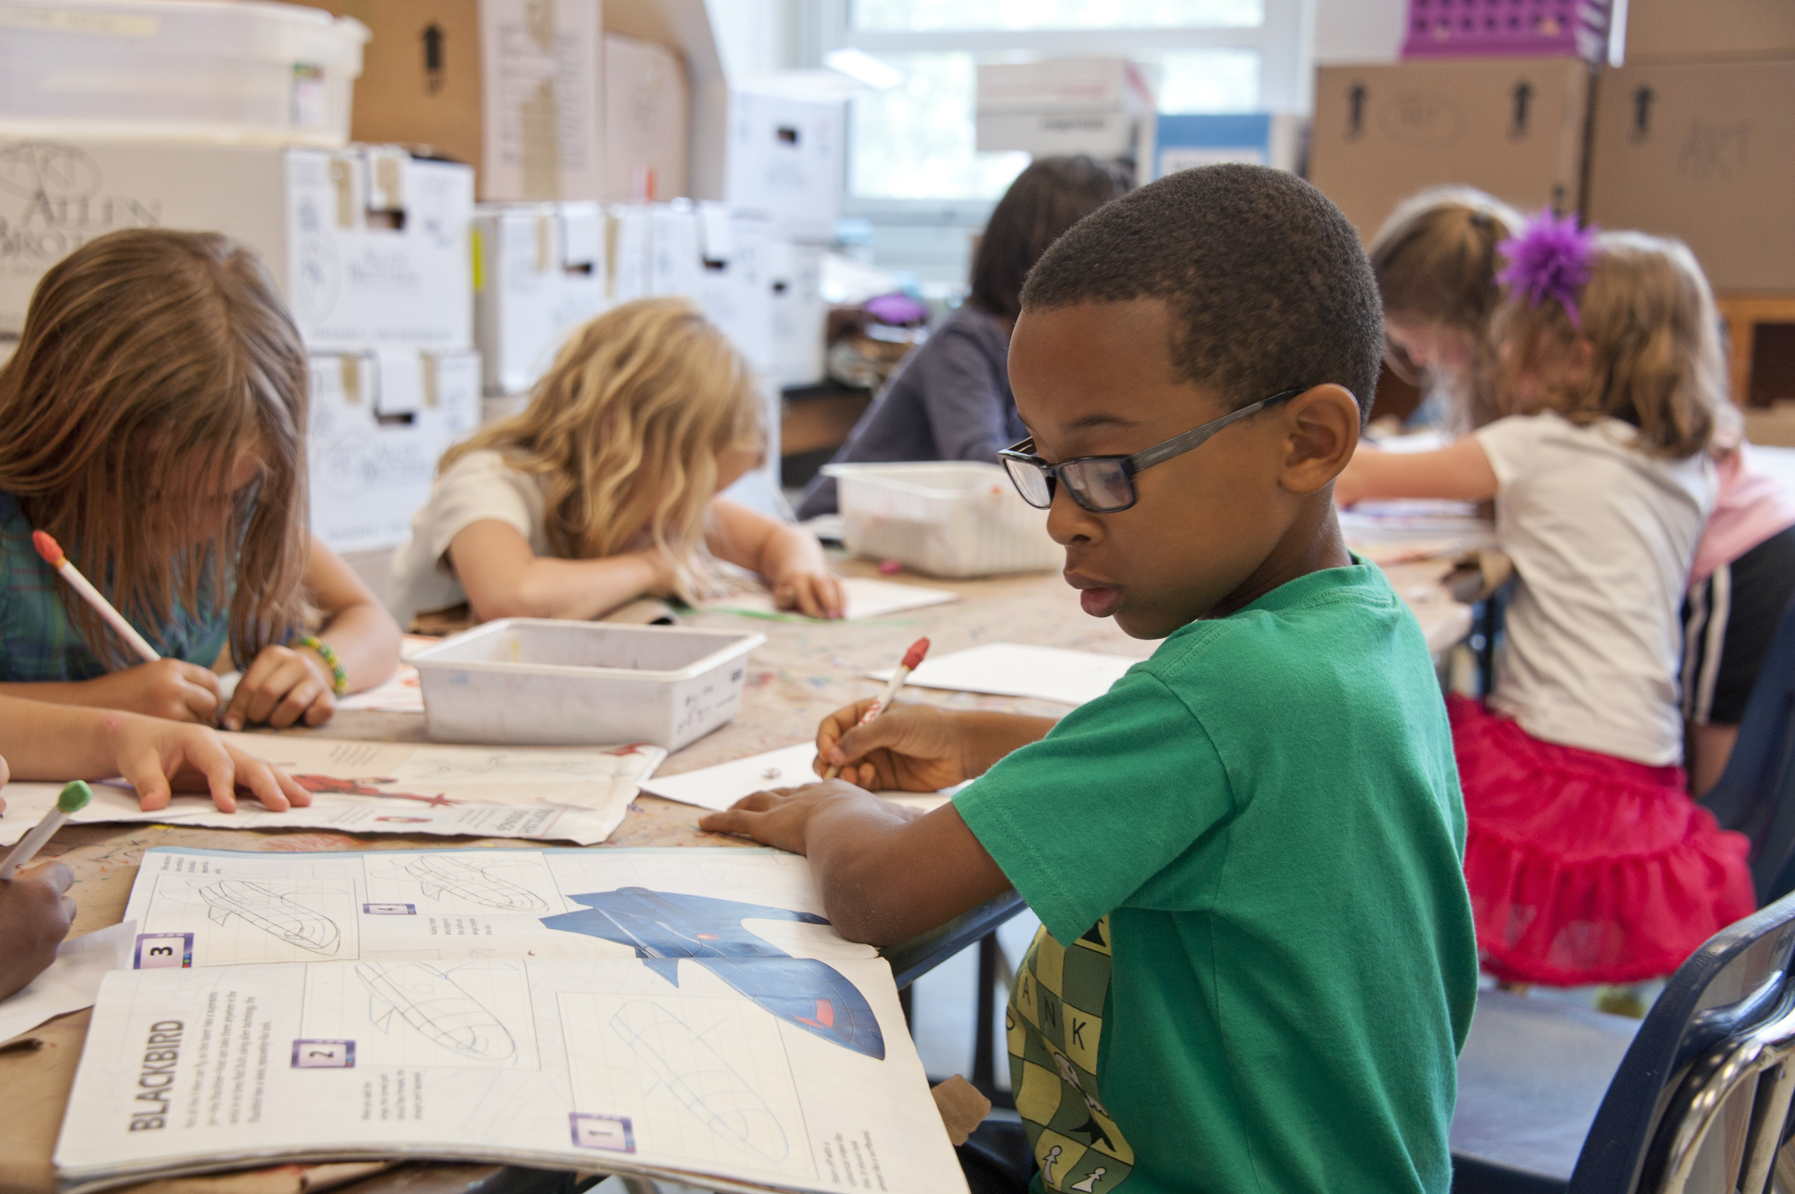
When and how do the tests happen?
The national window for administering these tests is the month of May..
We will not tell the children they are being tested or call them tests.
The children will work on the assessments in their own classroom in smaller groups to allow them to space out..
The assessments will be timetabled across the weeks to prevent the children feeling overwhelmed. To them, it will be like a usual English or maths lesson.
There is no writing test. The teachers will make a judgement using the children’s writing over the course of year 2.
Contents

Slide 10
What happens with the results?
Test results are not routinely shared with parents or published; they inform overall teacher assessments.
Unlike year 6 test results, year 2 results are not a definitive judgement. Teacher assessment can include all the work a child has done in key stage one and the test result merely supports this judgement.
The school will report all the teacher assessments to the local authority by the end of June 2022; we do not need to report individual test scores.
Teacher assessments of pupil attainment will be shared with parents in the end of year reports.
We will not tell the children they are being tested or call them tests.
The children will work on the assessments in their own classroom in smaller groups to allow them to space out.
The assessments will be timetabled across the weeks to prevent the children feeling overwhelmed. To them, it will be like a usual English or maths lesson.
There is no writing test. The teachers will make a judgement using the children’s writing over the course of year 2
Contents

Slide 11
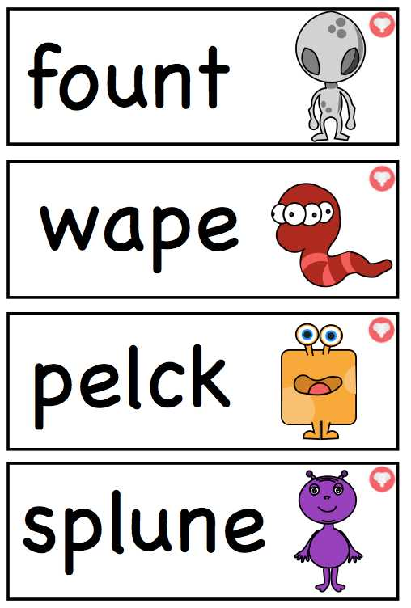
Year 1- Phonics Screening
In June, all Year One children will be expected to
undertake a phonics check. This has been cancelled
the last 2 years.
Children must read regular and nonsense words
by segmenting (breaking up) the sounds and blending
them back together. Children must be confident
with the sounds to be able to read nonsense words.
Children who are not at the expected level for reading
and writing are identified straight away and given the
appropriate intervention to help them achieve the
expected level.
If a child doesn't pass the phonic screening check, they will be given additional support to help them achieve a pass the following year.
The children who missed the phonic screening last year carried out the test in January and all passed.
Contents

Slide 12
How can I help my child?
Make sure they go to bed at a reasonable time, have a good breakfast and arrive at school on time during the assessment weeks.
Listen to your child read daily. Ask questions and talk about what they have read. Make sure they understand what they are reading. Check children understand the vocabulary in the book.
Use online activities like Phonics play, Times Tables Rockstars, Topmarks to practise skills at home.
Support your child to complete any home learning tasks, such as spelling activities, reading comprehensions and mental maths skills.
Contents

Slide 13
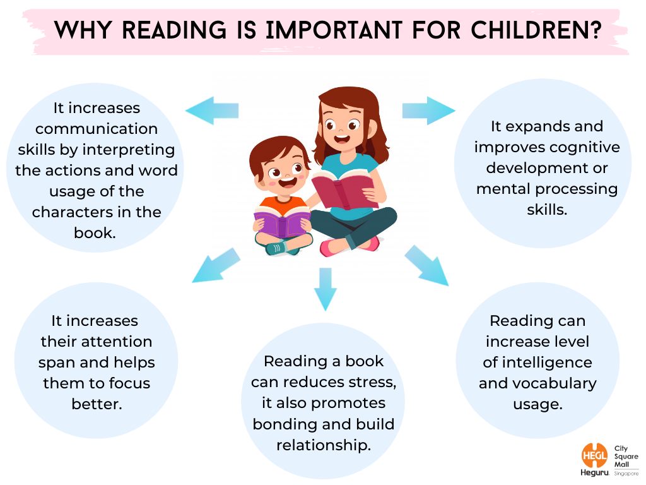
Contents

Slide 14
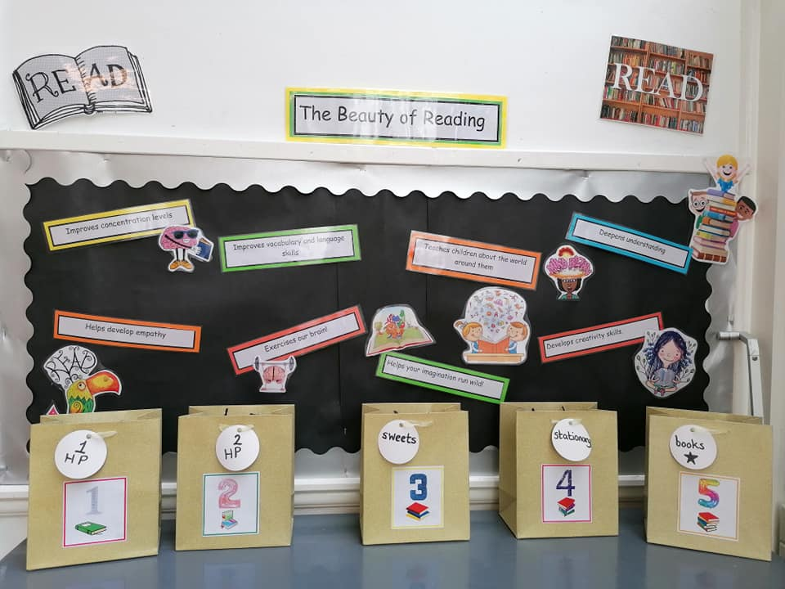
Incentive in Class 2

Slide 15
Reading at home!
Children get two reading books.
Please get your child to read both books twice to build fluency and expression.
Children will receive a reading book mark with key questions for parents to ask their child during or after reading.
Read to your child. This allows you to model expression and for children to hear what a good reader sounds like.
Make sure you read books beyond your child’s reading ability. This helps introduce new vocabulary and develop their own language skills.
Contents

Slide 16
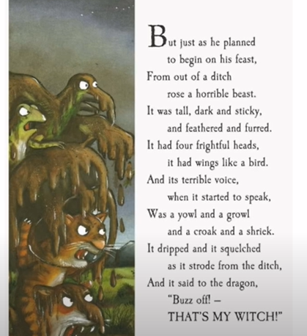
Example of discussion that could be had with your child to help build on their understanding.
Can you find a word that rhymes with ‘beast’?
Can you find a word that describes how the beast moves?
What words has the author used to describe the sounds that the animals used?
How do you think the dragon felt when seeing this beast?
Why do you think the animals had to go to this length at the end of the story?
Can you find any sounds they are learning this week? (ea)
What do you think the word ‘strode’ means?

Slide 17
Thank you for taking the time to find out about Class 2!

